Slide 1
SMARTSURV :
A 3D CNN that recognizes actions in video surveillance
Godfred S. Gyimah
‹#›
Notes:
Hello everyone. My name is Godfred and today, I’m here to talk about SmartSurv, which is a proof-of-concept for a 3D Convolutional Neural Network that recognizes actions in video surveillance.
So, what was the motivation for this project?
‹#›

Slide 2
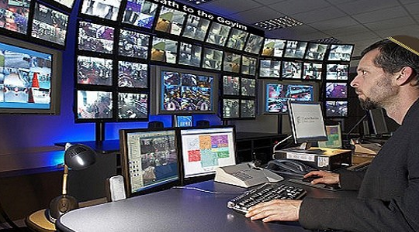
PROJECT MOTIVATION
CCTV operators typically monitor 16 to 64 cameras concurrently on the same screen.
Humans lose ~95% of their attention after focusing on a screen for 20+ mins (Green, 1999).
Some CCTVs are not monitored.
Solution ??: A system which recognizes certain actions and flags them.
‹#›
Notes:
Now, CCTV operators have really got their work cut out for them. On a typical day, they have to monitor 16 to 64 cameras at the same time for 8 hours and not a miss a thing.
There’s been some research into this and the results revealed that it’s actually impossible for humans to maintain any good level attention after focusing on a screen for 20+ minutes.
Also, some CCTVs are not monitored. All these suggest that a lot of things, in some cases, bad things could go unnoticed.
But what if, what if there was an intelligent system that is able to monitor activities on all 64 screens and alerts operators / authorities in charge when any situation demands closer scrutiny
‹#›

Slide 3
BENCHMARKS FOR ACTION RECOGNITION
MODEL | METHOD | ACCURACY | RECALL | PRECISION
Schindler et al. 2008 | 3D CNN (10 frames: 0.5s) | 92 | 88 | 89
Jhuang et al. 2007 | Multi-class SVM (frame-by-frame) | 91 | - | -
Niebles et al. 2008 | LDA & pLSA | 83 | 83 | 84
Dollar et al. 2005 | kNN & SVM | 81 | 81 | 83
Schludt et al. 2005 | SVM + Conv. Kernel | 71 | 72 | 77
Smartsurv | 3D CNN (50 frames: 5s) | ?? | ?? | ??
Notes:
So, the model was tested on unseen data and it gave about 87.5% accuracy performance. But a further scrutiny of other performance metric results show that the model actually achieves 100% recall for our target class, which implies that all box/fight incidents will be detected and so the model serves its purpose. 88% precision implies there will be a few false alerts of fights / box but future model improvement methods will focus on that.

Slide 4

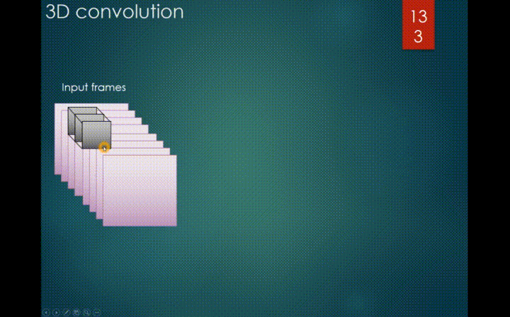
So, how do we teach a machine to understand actions in videos?
‹#›
Notes:
To answer this question, let’s consider what comic books and videos have in common: They all tell a story using a sequence of images. So, by taking a few images from different time frames in the video and stacking them up, we can slide a 3D convolution filter along the video tensor to extract features which tell the story of the image sequence, rather than the story of individual images. .
‹#›

Slide 5
MODEL PIPELINE
Input Video: 1, 160, 120, 150
Video reduced: 1, 20, 20, 100
3D Conv. Layer (32, 16,16,51)
Activation: Relu
3D Max Pool. Layer (32, 5, 5, 5)
Dropout (0.5)
Flatten (4000)
Dense (Relu) 128
Dropout (0.5)
Dense (Softmax) 4
Notes:
This is a schematic of the model pipeline.. The original video is first reduced in size by about 6 to 8 fold in order to reduce the number of parameters we’ll have to train. Then by feeding it through 3D Convolutions, Maxpooling and Dense layers, we end up with 4 classes, one for each of our actions.

Slide 6
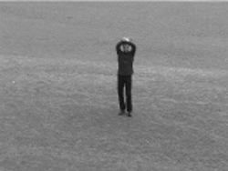
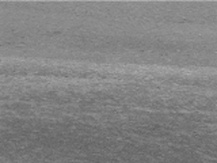
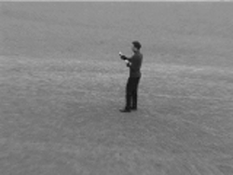
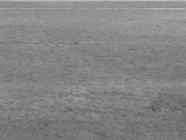
MODEL INPUTS: KTH DATASET
4 action classes
400 videos
Boxing / Fighting
Running
Walking
Waving
Train: 80%
Validation: 10%
Test: 10%
‹#›
Notes:
The dataset I used for this project was the KTH dataset, where I have 100 videos from each of 4 different action classes,
‹#›

Slide 7
MODEL INPUTS: Train Parameters
Optimizer: RMSprop (lr: 0.001)
Loss function: Cross Entropy
Training Time: 1000 epochs
1 hour on a 16GB P5000 GPU
‹#›
Notes:
So, these were some of the parameters I chose and on a P5000 GPU, it takes about 1 hour for the model to fully run.
‹#›

Slide 8
MODEL RESULTS
‹#›
Notes:
‹#›

Slide 9
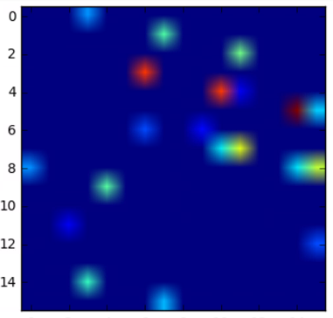
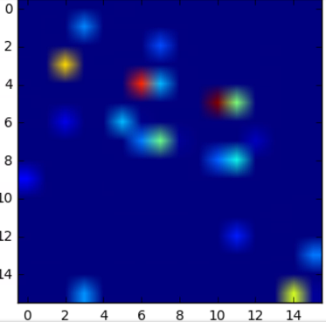
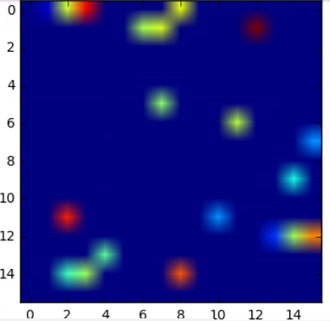
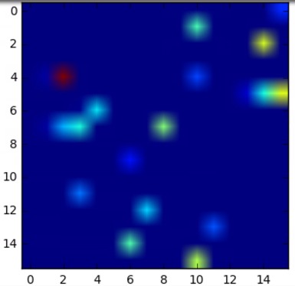
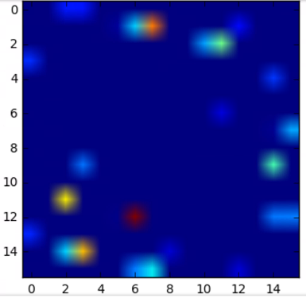
RESULTS: 3D CONVOLUTIONS
5/51 Feature map samples from 1/32 filters for video 5 (boxing)
(i)
(ii)
(iii)
(iv)
(v)

Slide 10
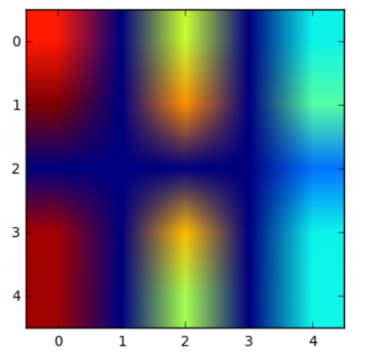
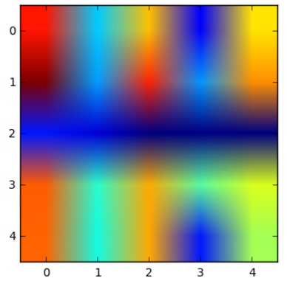
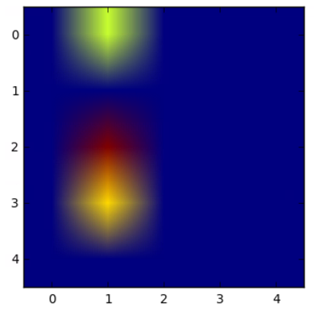
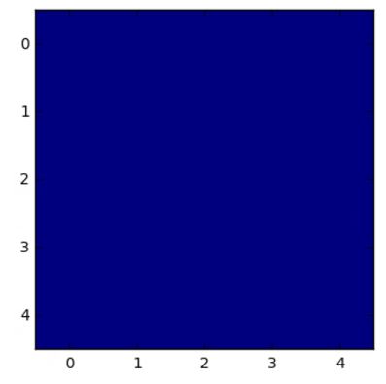
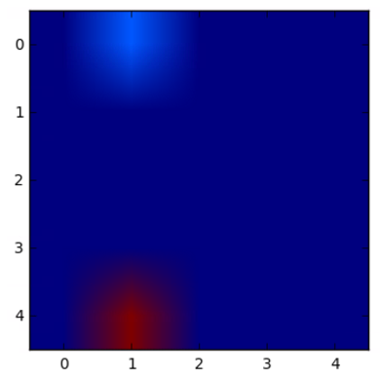
RESULTS: 3D MAXPOOLING STAGE
Feature maps from 5 seconds of a ‘walking’ class action
(i)
(ii)
(iii)
(iv)
(v)

Slide 11
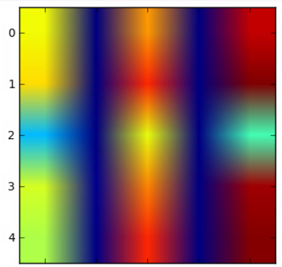
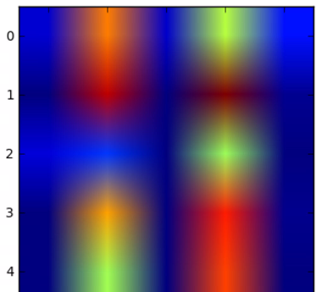
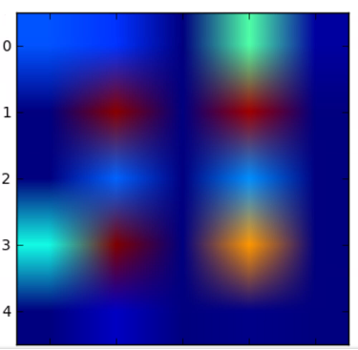
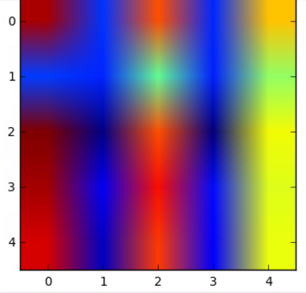
RESULTS: 3D MAXPOOLING STAGE
Feature maps for sample 3-D Maxpool filters
Boxing / Fighting
Walking
Waving
Running

Slide 12
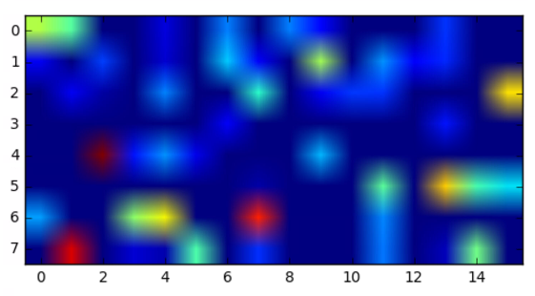
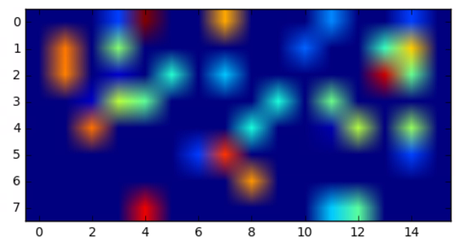
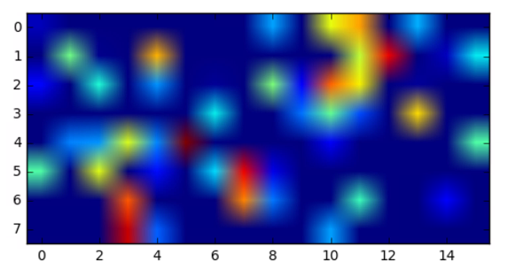
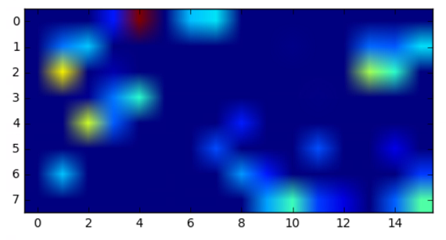
RESULTS: 128-node DENSE LAYER
Walking
Boxing / Fighting
Running
Waving

Slide 13
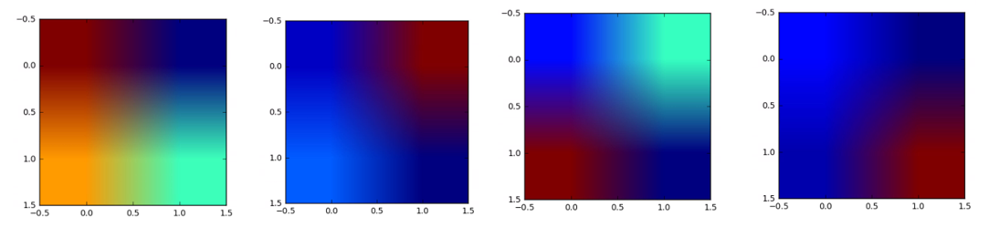
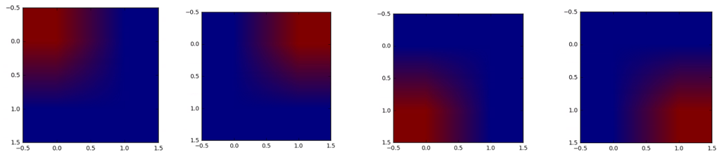
RESULTS: 4-node DENSE LAYER
Boxing / Fighting
Running
Walking
Waving
FINAL LAYER: Softmax

Slide 14
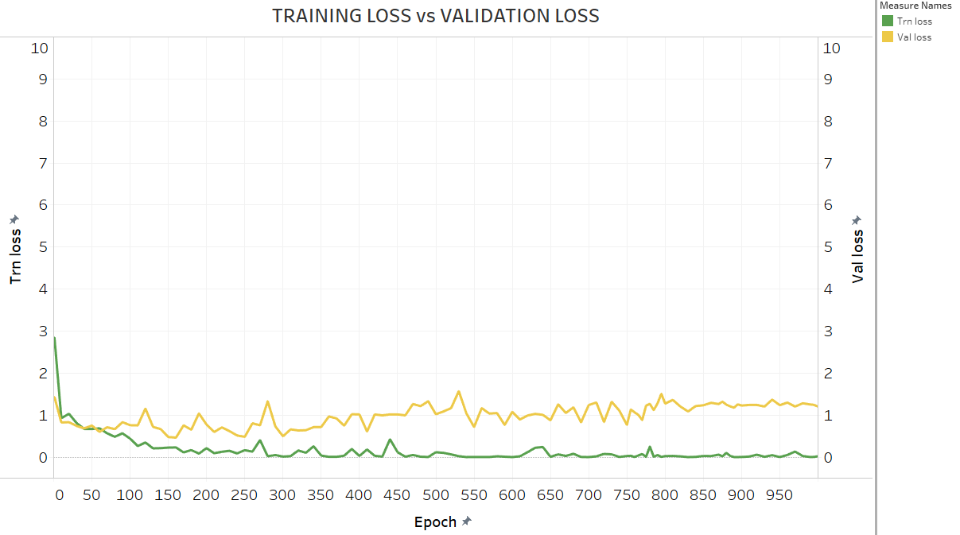
MODEL RESULTS: LOSSES
Notes:
The training & validation losses both follow generally-expected trends, with the train loss being quite lower than the val loss.

Slide 15
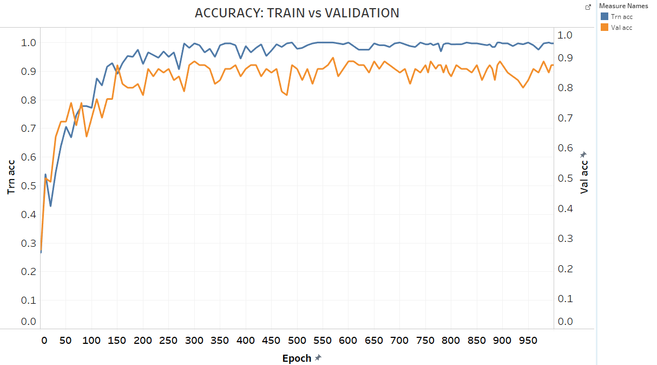
MODEL RESULTS:
Notes:
The accuracy results shows a 100% for train and only about 87 to 90 for validation, which suggests slight overfitting. But accuracy alone doesn’t tell the whole story here.

Slide 16
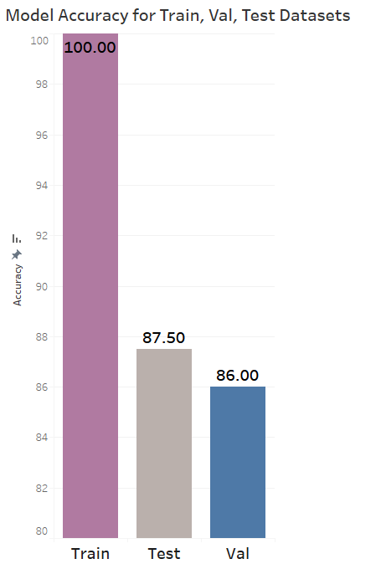
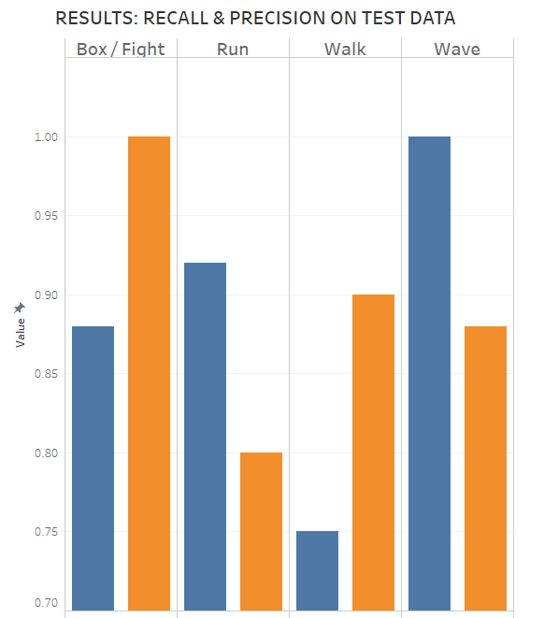
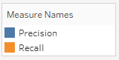
MODEL RESULTS ON UNSEEN DATA
Notes:
So, the model was tested on unseen data and it gave about 87.5% accuracy performance. But a further scrutiny of other performance metric results show that the model actually achieves 100% recall for our target class, which implies that all box/fight incidents will be detected and so the model serves its purpose. 88% precision implies there will be a few false alerts of fights / box but future model improvement methods will focus on that.

Slide 17
COMPARING MODELS ON SAME DATASET
MODEL | METHOD | ACCURACY | RECALL | PRECISION
Schindler et al. 2008 | 3D CNN (10 frames: 0.5s) | 92 | 88 | 89
Jhuang et al. 2007 | Multi-class SVM (frame-by-frame) | 91 | - | -
Smartsurv | 3D CNN (50 frames: 5s) | 88 | 89 | 90
Niebles et al. 2008 | LDA & pLSA | 83 | 83 | 84
Dollar et al. 2005 | kNN & SVM | 81 | 81 | 83
Schludt et al. 2005 | SVM + Conv. Kernel | 71 | 72 | 77
Notes:
So, the model was tested on unseen data and it gave about 87.5% accuracy performance. But a further scrutiny of other performance metric results show that the model actually achieves 100% recall for our target class, which implies that all box/fight incidents will be detected and so the model serves its purpose. 88% precision implies there will be a few false alerts of fights / box but future model improvement methods will focus on that.

Slide 18
THE MODELING METHOD: OTHER BUSINESS CASES
Self-driving Vehicles
Autonomous Excavation
Content-based video search engines
- Youtube : 20 hours of new videos per minute.
Generally, for many problems involving:
- video data
- images (in a sequence)
‹#›
Notes:
Self-driving cars, where the system has to be able to recognize the actions of pedestrians, crossing the road. Or in the case of autonomous excavators, which is my PhD research area, where the task is usually for the autonomous excavator to recognize and understand the actions of other autonomous equipment within the excavation area.
Other application areas include CBVS engines like youtube and generally, for MANY (not any) problems involving videos or images, the method could be tweaked to solve the problem.
‹#›

Slide 19
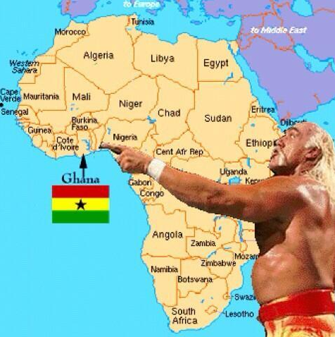
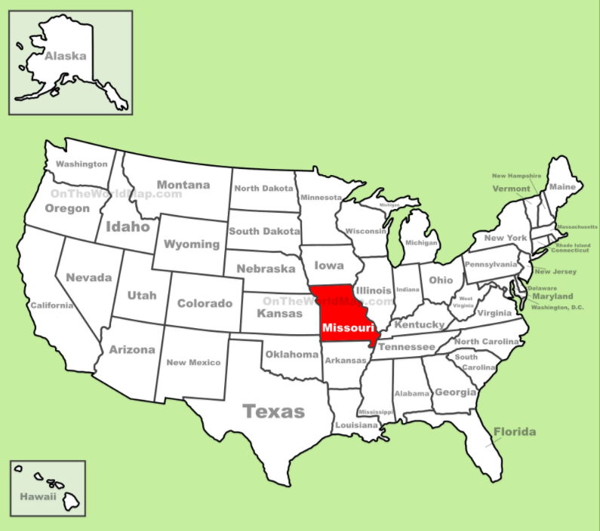
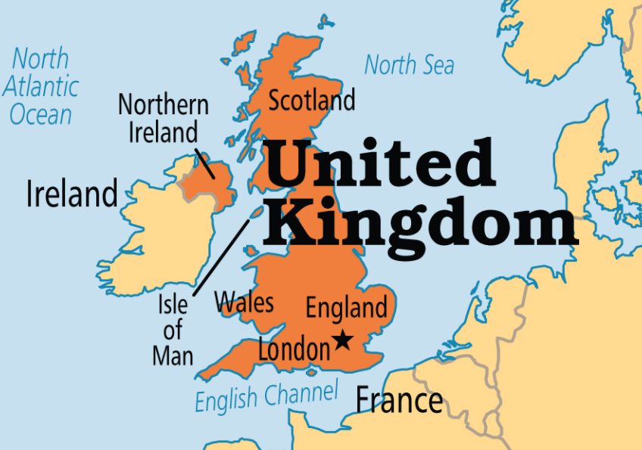

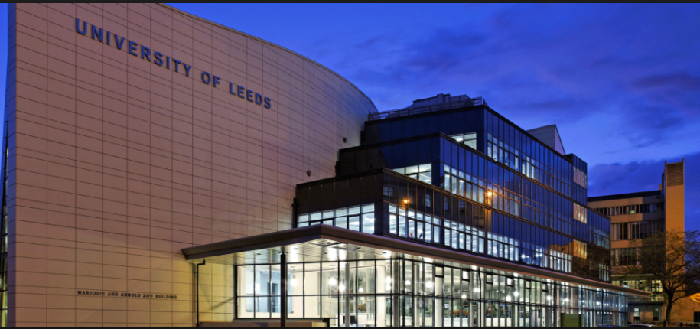
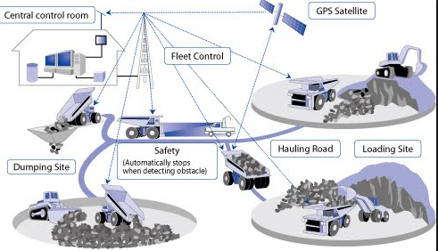
ABOUT GODFRED...
Civil Engineer
Engineering Analytics
. (3 years)
Geological Scientist
PhD Research (Autonomous Excavation using Computer Vision & Machine Learning)
‹#›
Notes:
‹#›

